Slide 1
Congressional Apportionment Modeling
Joey Logan and Stephanie Sullivan
Data Jawn | Philadelphia, PA | June 12, 2019
Notes:
STEPHANIE

Slide 2
Objectives
Develop a projection of 2020 population data by state using published United States Census Bureau population data¹
Identify states projected to lose or gain congressional seats using Congressional apportionment formula²
Calculate impact on state representative workload
Adjust apportionment model to include DC and Puerto Rico statehood
Create interactive maps to showcase findings for broad consumption
Notes:
STEPHANIE

Slide 3
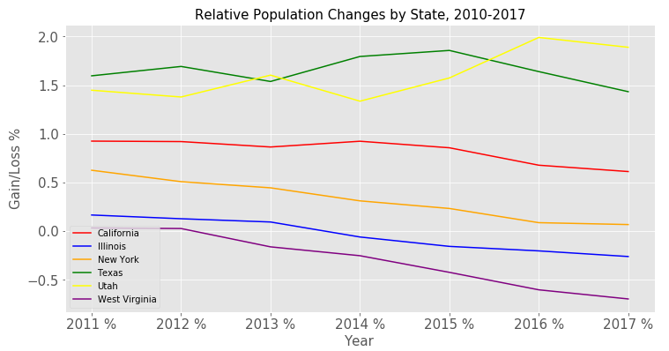
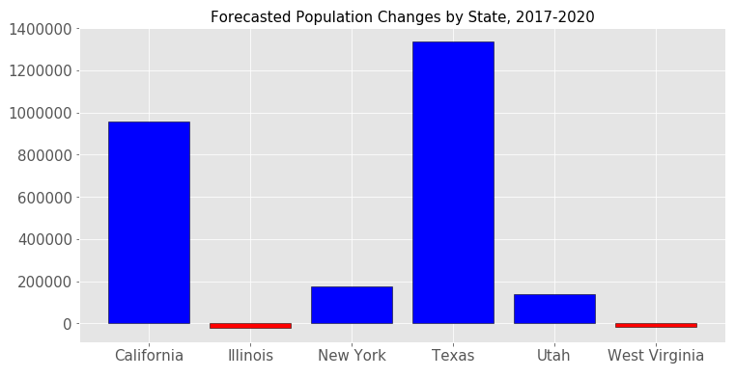
Population Projections
Calculated:
Gross population for each state for 2018, 2019, 2020
Linear Regression
Relative population change between years
Population change between 2010 and 2020
Notes:
CLICK TO ADVANCE SCREENSHOTS – bar graph and line graph
Forecasted populations for 2018, 2019, and 2020
Projections created using a linear regression model
Selected a subset of states to dive into
Bar chart: gross population between 2017 and 2020
Line chart: Year over Year percent population changes to normalize data

Slide 4
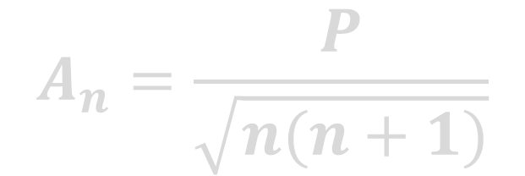
What is Congressional Apportionment?
Seat assignments in House of Representatives based on state population
Each state allotted a minimum of one representative
Congressional apportionment is the calculation of congressional seat assignments for each state based on decennial population data
$$A_{n}=\frac{P}{\sqrt{n(n+1)}}$$
P = state population
n = number of senators assigned
A = apportionment priority value
Notes:
House of Representatives is comprised of 435 seats.
Each state is assigned one representative regardless of the population of the state, leaving 385 seats to be assigned.
Distribution of these seats is reevaluated every 10 years using a method of equal proportions.
Each state is assigned an initial priority that is the population divided by square root of 2 because they each have an n = 1 value. Those priorities are then put in descending order.
The state at the top of the list is given an additional seat, the number of seats is reduced by 1 and priority is recalculated using the new n value.

Slide 5
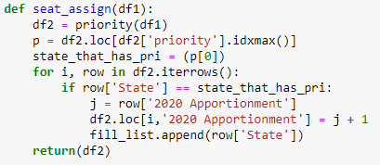
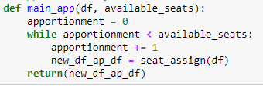
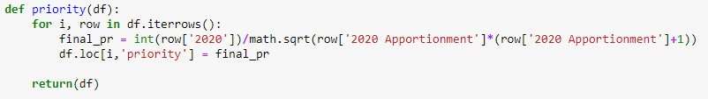
Congressional Apportionment Model
Step 1: Assign each state one representative
Step 2: Using apportionment formula, iterate through remaining seat assignments
Notes:
First Function: Takes population dataframe and available seats, sets apportionment = 0 to start, then as long as the number of seats assigned is less than the seats available, the data frame is passed into subsequent functions
Second Function: calculates priority → jump to third function
Third Function: apportionment formula from previous slide with references to population dataframe values, passes priority ranked dataframe back into second function
Second Function: State with highest priority gets a seat assigned

Slide 6
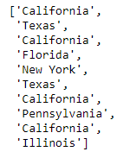
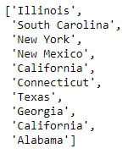
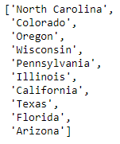
Congressional Apportionment Model
First 10 Assignments
Assignments 175-184
Last 10 Assignments
Notes:
To illustrate, you can see the first ten states awarded seats based on their priority. You can see that the populations of the largest states is so great, the first ten seats are divided over only six states.
A random selection of the middle states assigned so that other states are in the mix, but California, Texas, and New York are still actively being assigned seats.
In the last ten seat assignments, you can still see the impact of large states – CA, PA, TX, IL

Slide 7
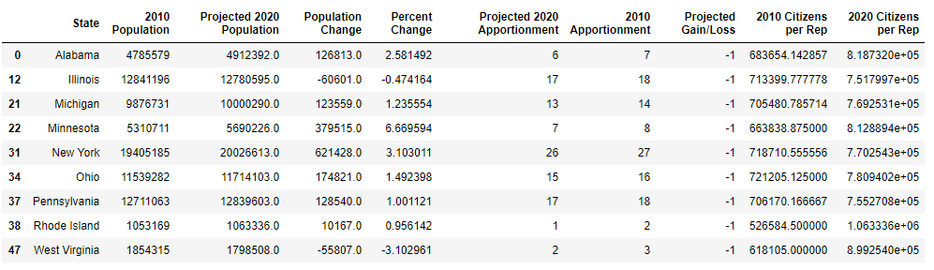
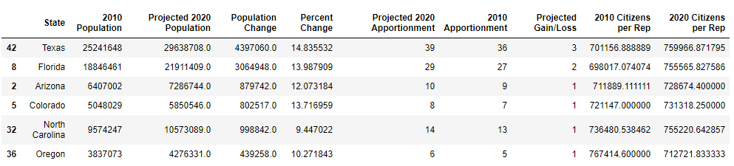
Winners and Losers
Winners
Losers
Notes:
This is the final dataframe – all columns except state, 2010 Population, and 2010 Apportionment were forecasted or calculated by us.
Apportionment formula created the Projected 2020 Apportionment column
This view shows states slated to gain at least one representative as a result of the 2020 decennial census.
Note the major population growth of these states (9%+)
This view shows states slated to lose one representative as a result of the 2020 decennial census.
What you notice is that not all states are actually decreasing in population but the relative growth is small.

Slide 8
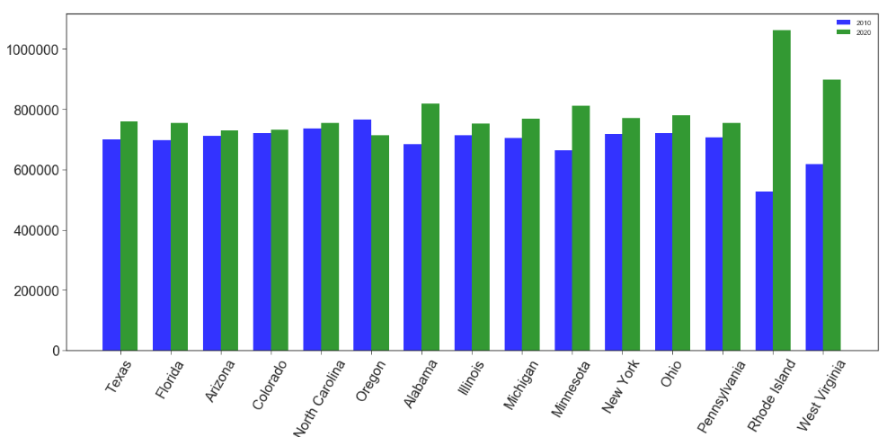
Congressional Workload
Rep Gains
Rep Losses
Notes:
In addition to apportionment, we wanted to get a sense of the impact on congressional representative workload for states gaining and losing seats.
In most cases, even states gaining seats are seeing an increase in the number of citizens each representative is responsible. Exception: Oregon.
Most notably, representatives in Rhode Island (2 seats to 1) and West Virginia (3 seats to 2) have a substantial increased workload
It should be noted, this is an estimate as congressional districts are not all equal in size.
Issue: makes it more challenging for representatives to connect with all constituents.

Slide 9
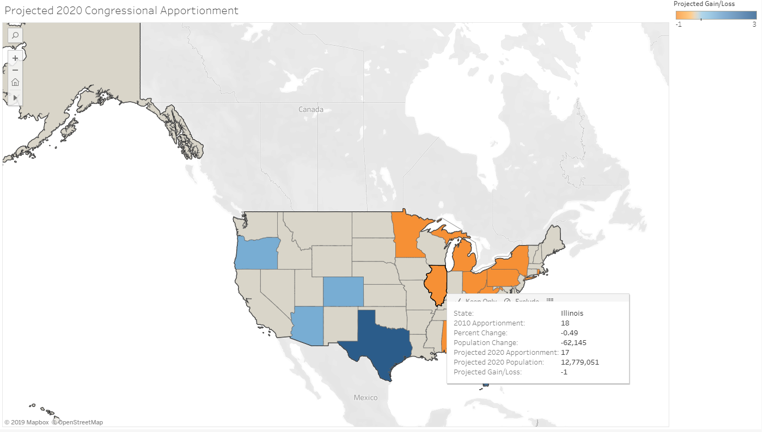
Notes:
Took results and put them in a Tableau visualization that color codes the map based on the congressional losses and gains.
Hovering over each state allows you to see the data points collected/calculated

Slide 10
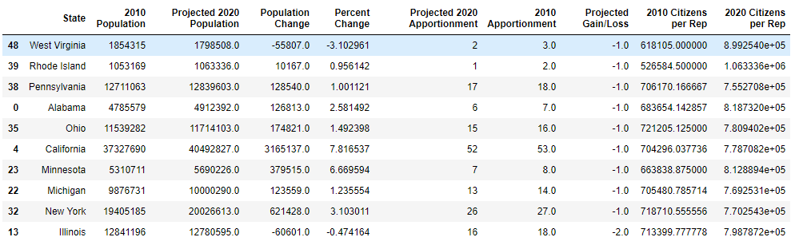
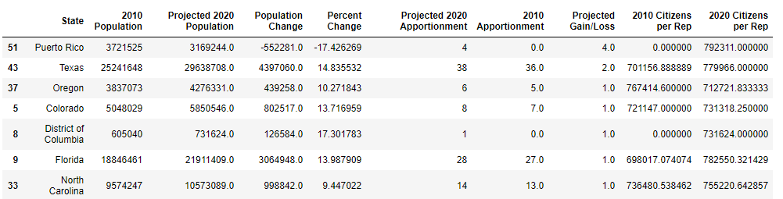
What about DC and Puerto Rico?
Adjust the number of available seats (385 to 383)
Winners
Losers
Notes:
Apportionment history
1913 – set at 435
1929 – capped by legislation at 435
1959 – temporarily increased to 437 to accommodate Alaska (January 1959) and Hawaii (August 1959) statehood
1962 – following 1960 decennial census, reduced back down to 435 with Alaska and Hawaii
An interesting question when considering government representation is what about Washington DC and Puerto Rico? Neither has representation in the House or Senate currently.
As an exercise, we incorporated them if they were to achieve statehood by 2020 into our population projections and apportionment to see how that impacted seat assignment across the entire House of Representatives.
Puerto Rico gain the most
DC only one
Illinois loses two instead of one
Table comparing winners and losers

Slide 11
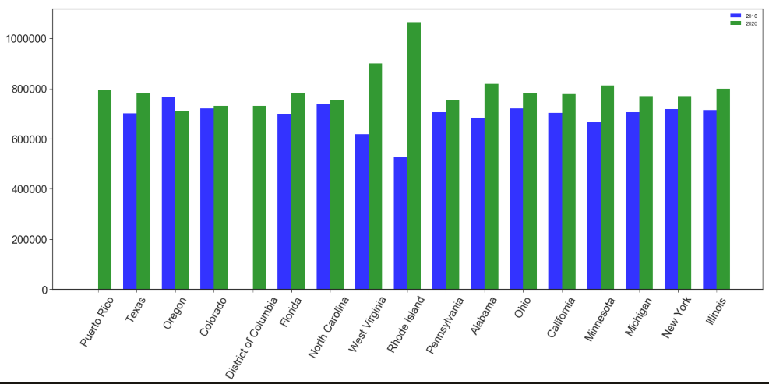
Congressional Workload, Revisited
Rep Gains
Rep Losses
Notes:
STEPHANIE

Slide 12
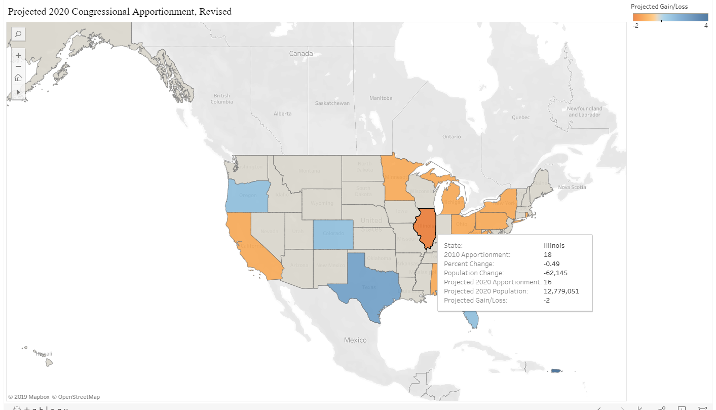
Notes:
STEPHANIE

Slide 13
Sources
U.S. Census Bureau. (2018). Annual Estimates of the Resident Population by Sex, Age, Race, and Hispanic Origin for the United States and States: April 1, 2010 to July 1, 2017 [Data set]. Retrieved from: https://factfinder.census.gov/faces/tableservices/jsf/pages/productview.xhtml?pid=PEP_2017_PEPASR6H&prodType=table
U.S. Census Bureau. (n.d.). Computing Apportionment. Retrieved from Congressional Apportionment: https://www.census.gov/population/apportionment/about/computing.html
Notes:
STEPHANIE

Slide 14
Questions?
Joey Logan – jrl362@drexel.edu
Stephanie Sullivan – stephanie.m.sullivan@gmail.com
Notes:
STEPHANIE

